Slide 2
Using SQL to Prepare Data for Analysis
Dr. John Delano

Slide 3
Agenda
Administrative Items
What is SQL?
Select/From/Where
Aggregate Functions
Group By
Joining Multiple Tables
Notes:
Admin Items:
Attendance
AIS Data Analysis Challenge

Slide 4
What IS SQL?

Slide 5
What is SQL?
Structured Query Language (SQL) was developed by the IBM Corporation in the late 1970’s.
SQL was endorsed as a U.S. national standard by the American National Standards Institute (ANSI) in 1992 [SQL-92].
Newer versions exist, and they incorporate XML and some object-oriented concepts.

Slide 6
What is SQL?
SQL is not a full featured programming language like C, C#, or Java
SQL is a data sublanguage for creating and processing database data and metadata.
SQL is ubiquitous in enterprise-class DBMS products.
SQL programming is a critical skill.

Slide 7
What is SQL?
SQL statements can be divided into three categories:
  Data definition language (DDL) statements
    Creating tables, relationships, etc.
  Data manipulation language (DML) statements
    Used for queries and data modification
  SQL/Persistent Stored Modules (SQL/PSM) statements
    Add procedural programming capabilities

Slide 8
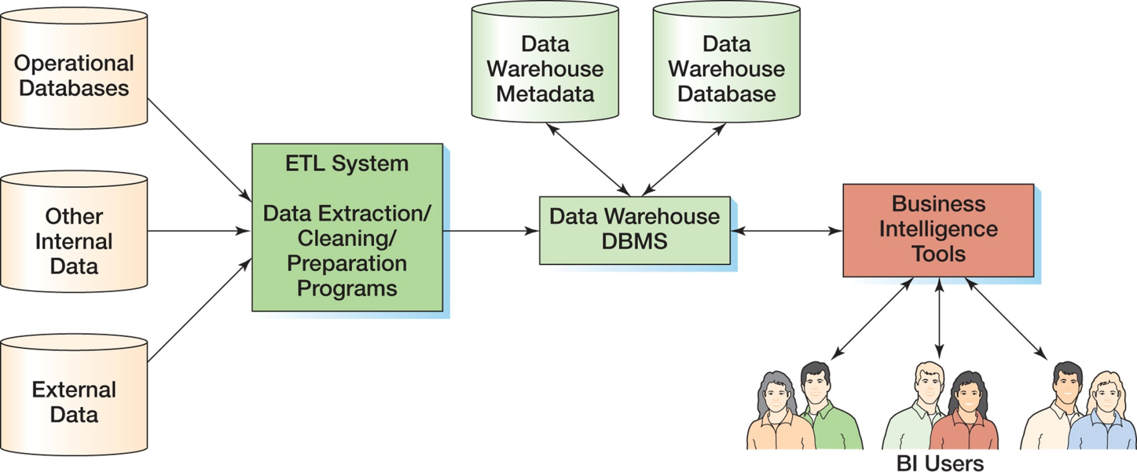
Where is SQL Used?
Notes:
Two places where SQL is used: ETL to pull from operational databases and other data sources to put into a data warehouse, and BI for reporting
Focus tonight is on ETL, so we’ll look at how we extract data from an operational database and clean data from other data sources in preparation for analysis. It’s all about laying the foundation.

Slide 9
SQL Tools
SQL Server Management Studio
MySQL Workbench
Oracle Database Client
Northwind Database SQL

Slide 10
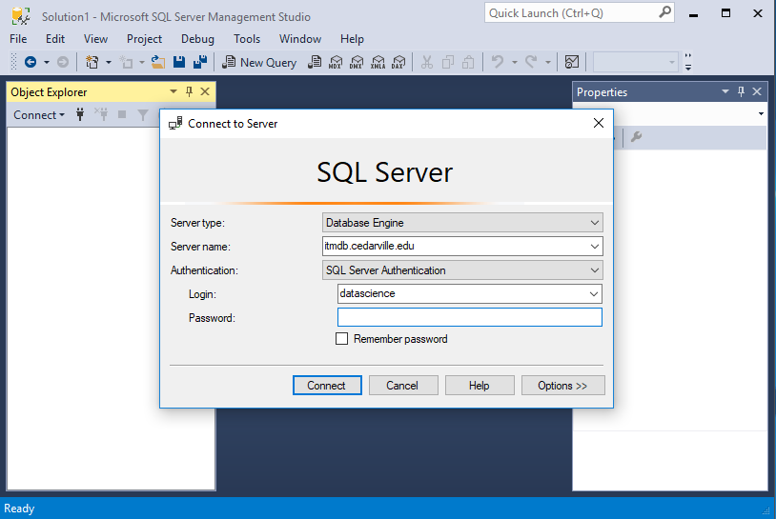
SQL Server Management Studio
Server name: itmdb.cedarville.edu
Login:
datascience
Password:
Analytics

Slide 11
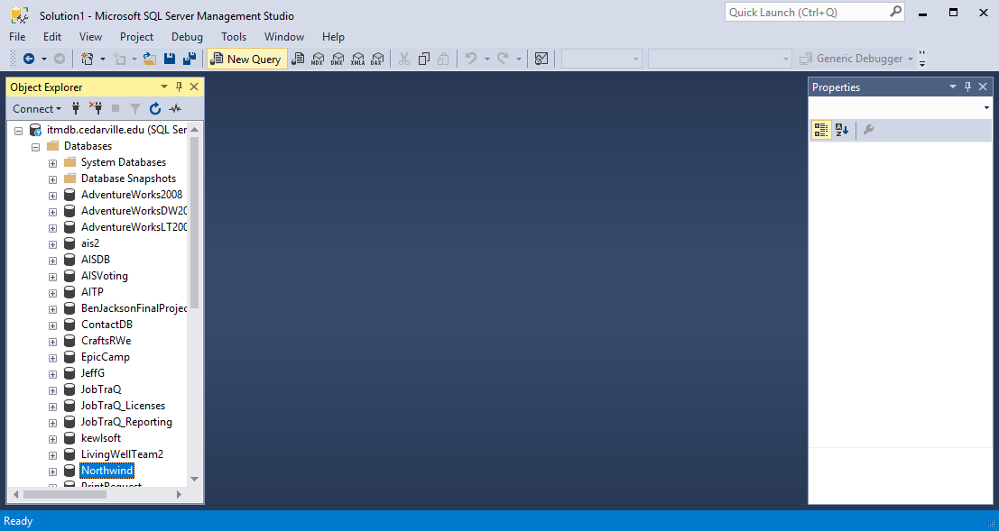
SQL Server Management Studio
Click New Query

Slide 12
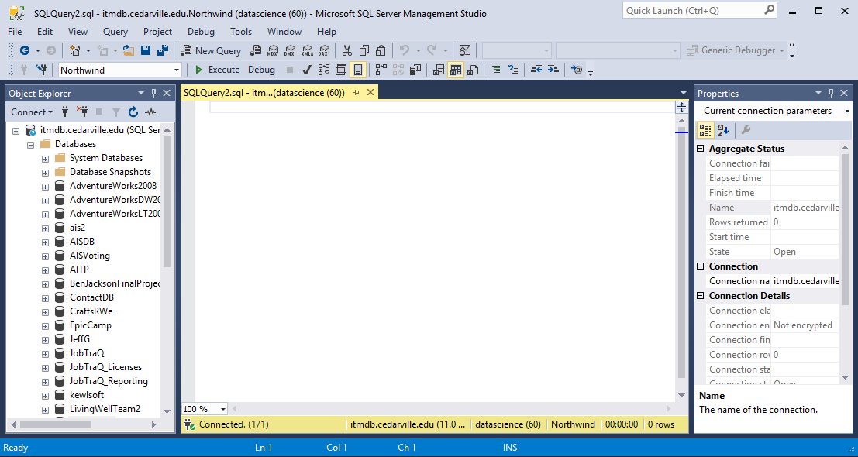
SQL Server Management Studio
Change this to Northwind

Slide 13
SQL Server Management Studio
This is where you will enter your SQL Queries

Slide 14
SQL Server Management Studio
To run a query, click Execute

Slide 15
SELECT…FROM…WHERE

Slide 16
SELECT..FROM
The fundamental framework for an SQL query is the SQL SELECT statement.
  SELECT {ColumnName(s)}
  FROM {TableName(s)}
  WHERE {Condition(s)}
All SQL statements end with a semi-colon (;).

Slide 17

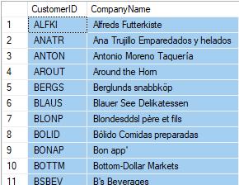
Columns From One Table
Notes:
What you see here is a snippet of the results from this query on the Northwind database that you can download into a SQL Server instance

Slide 18

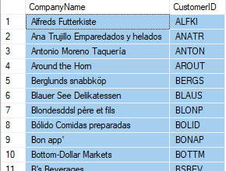
Column Order
Notes:
Note how the column order changes, based on the order of the select line

Slide 19

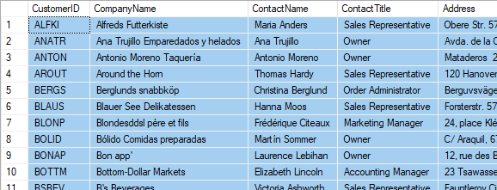
Specifying All Columns
Notes:
All columns are retrieved (but cut off on the screen)

Slide 20
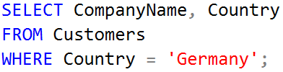
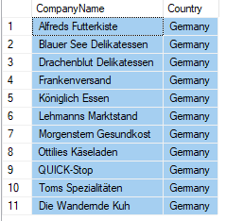
Filtering Rows in One Table
Notes:
Note that we need to mark text-based criteria values in single quotes, but numeric values are used without the quotes.

Slide 21
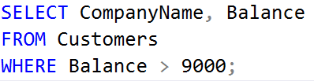
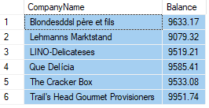
Filtering Rows in One Table
Notes:
Note that we need to mark text-based criteria values in single quotes, but numeric values are used without the quotes.

Slide 22


Filtering Rows -- AND
Notes:
Note that we need to mark text-based criteria values in single quotes, but numeric values are used without the quotes.

Slide 23
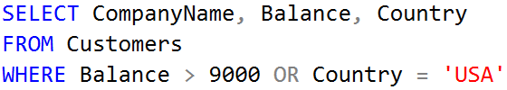
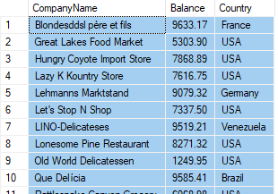
Filtering Rows -- OR
Notes:
Note that we need to mark text-based criteria values in single quotes, but numeric values are used without the quotes.

Slide 24


Filtering Rows -- BETWEEN
Notes:
BETWEEN is inclusive of the end values.

Slide 25
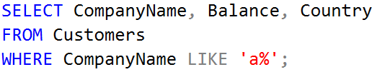

Filtering Rows -- LIKE
Notes:
Note that this retrieves Company names that start with A (case-insensitive, because that is the collation sequence used for my database!)
% is a wildcard search character
Underscore is a single character search

Slide 26
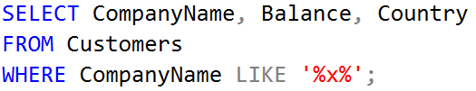

Filtering Rows -- LIKE
Notes:
Wildcard used on both sides means find a value that has x in it somewhere.

Slide 27
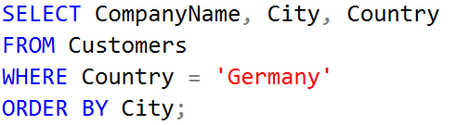
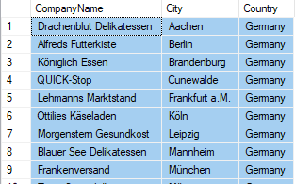
Sorting Rows in One Table

Slide 28
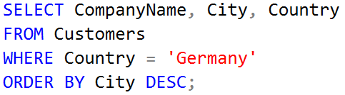
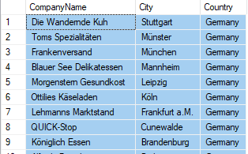
Sorting Rows in One Table

Slide 29
Aggregate Functions

Slide 30
Aggregate Functions
COUNT
SUM
AVG
MIN
MAX

Slide 31
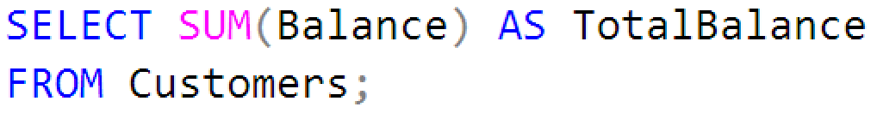

Using Aggregate Functions in SQL

Slide 32
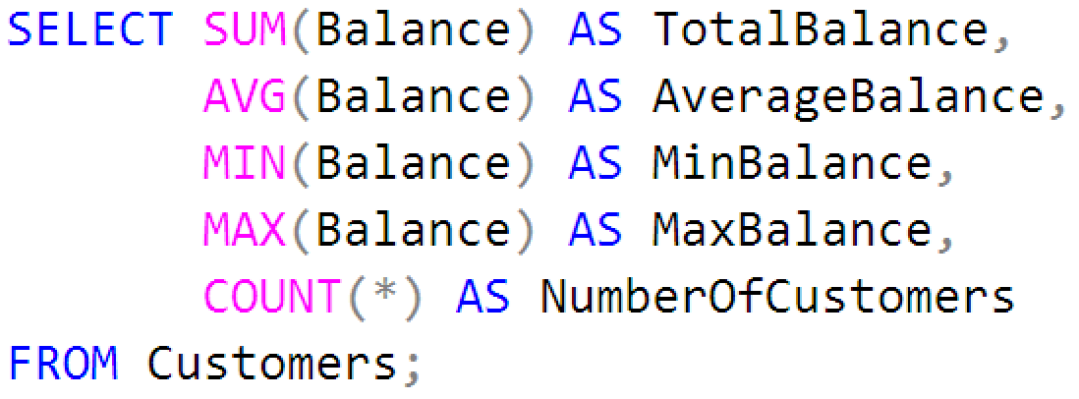
Using Aggregate Functions in SQL
Notes:
Note that we specify a * for Count, because we are aggregating the entire row, not just a column

Slide 33
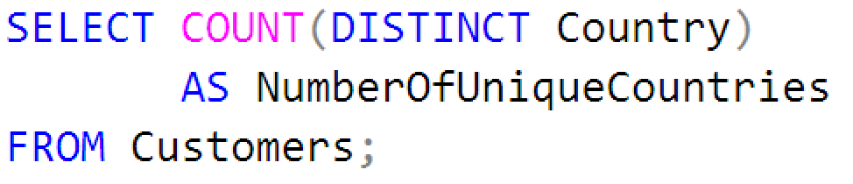

Using Aggregate Functions in SQL
Notes:
Note that we specify a * for Count, because we are aggregating the entire row, not just a column

Slide 34
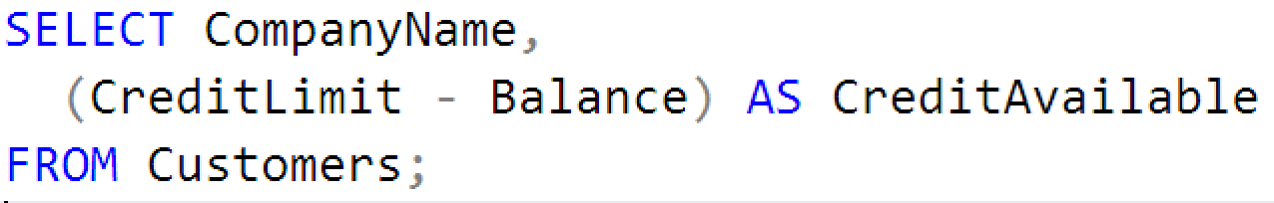
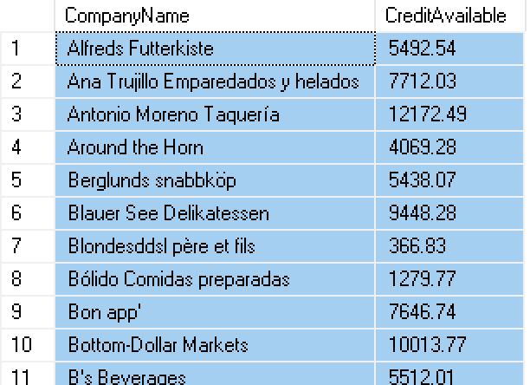
Calculated Columns in SQL
Notes:
Note that we specify a * for Count, because we are aggregating the entire row, not just a column

Slide 35
Group By

Slide 36
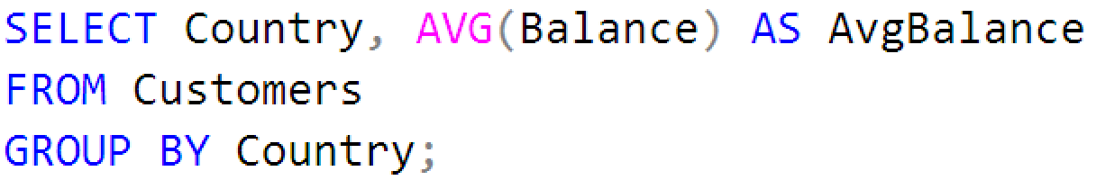
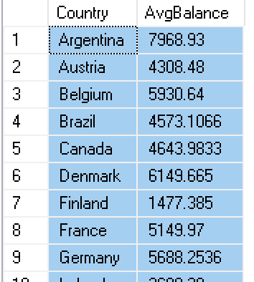
GROUP BY
Notes:
Note that to you typically specify an aggregate column on the select line and a non-aggregate included in the group by line
All non-aggregate fields on the select line, MUST be in the Group By statement.

Slide 37
JOINING TABLES

Slide 38
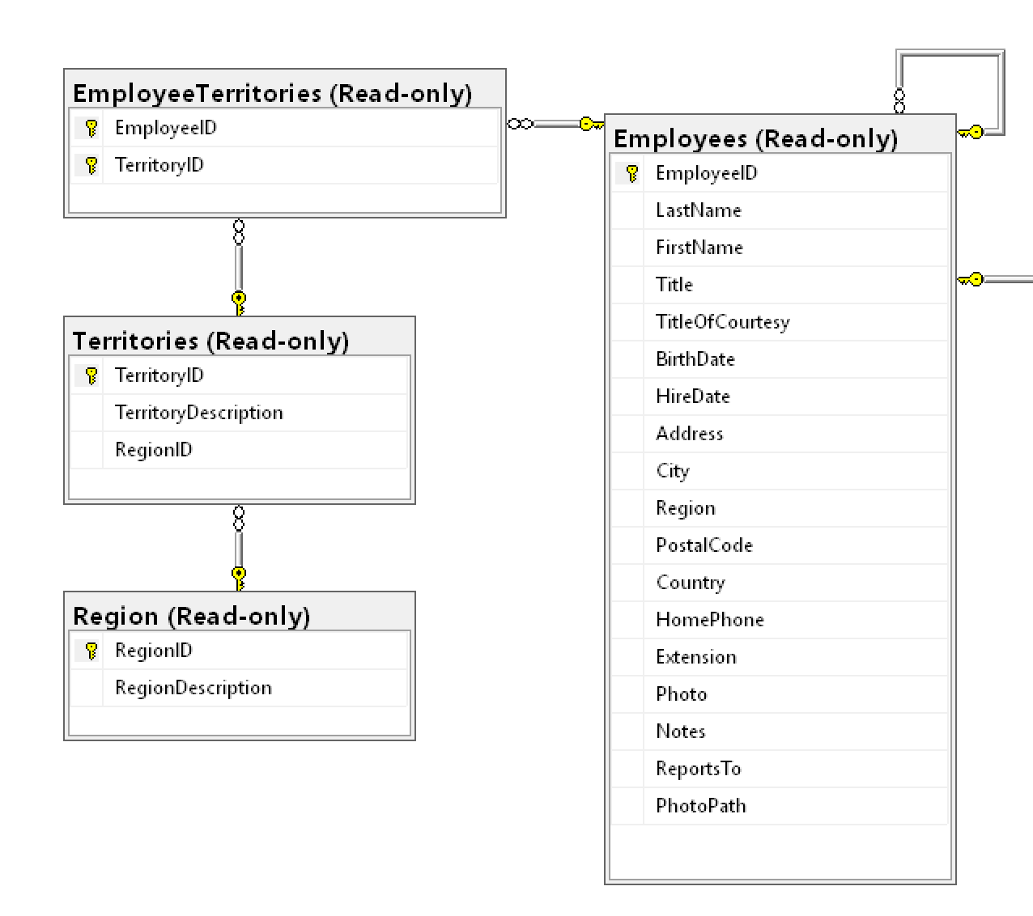
Why Join?
Consider this diagram.
What if I want to know which region has the highest number of employees?

Slide 39
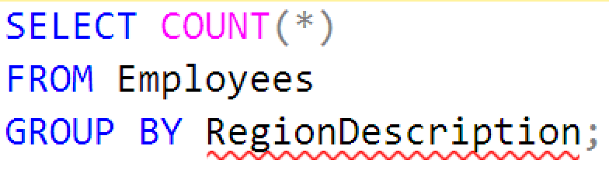
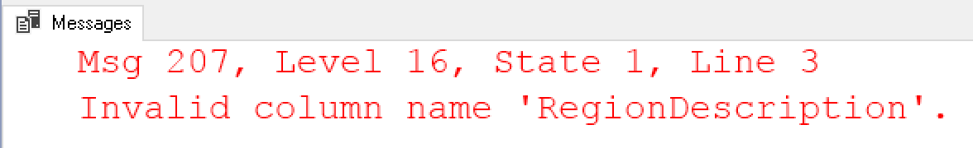
JOIN
What if we tried this?
Notes:
Doesn’t work, because RegionDescription is not in the Employees table

Slide 40
JOIN Syntax
Joins are used in the FROM clause to connect two or more tables together, based on their common “keys”
FROM Table1 JOIN Table2 ON Table1.PrimaryKey = Table2.ForeignKey

Slide 41
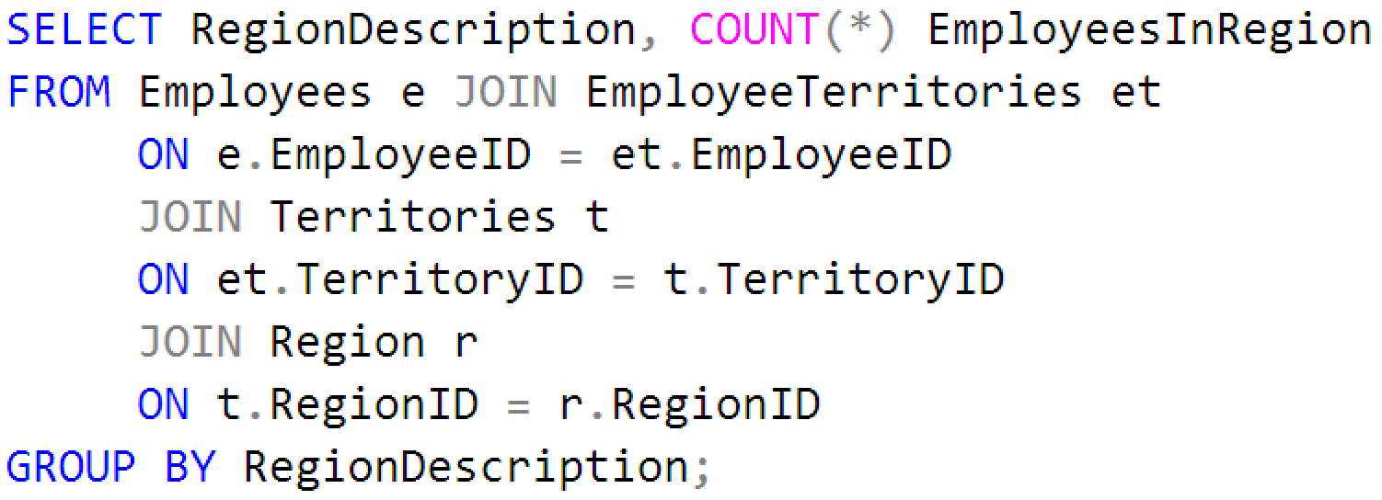
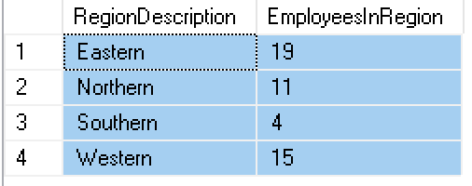
JOIN
Notes:
Might want to talk about the tendency to want to use MAX here instead of COUNT. Really what we are looking for is the MAXIMUM COUNT, so COUNT has to go first.

Slide 42
Preparing for Data Analysis

Slide 43
Preparing for Data Analysis
First, find out how much data you have (run a select count query on each table)
Look for any “dirty” or missing data
(run a group by/count query on any description fields)
Learn how tables are related
(look for primary keys/foreign keys)

Slide 44
For Further Study

Slide 45
For Further Study
SQL allows us to use the HAVING clause to specify criteria. How is this different than WHERE?
You can create your own aggregate function to use in SQL, using C#. For example, can you figure out how to create a concatenation function to join all the string values in a database column into a comma separated list?

Slide 46
For Further Study
There are two types of joins: Inner and Outer. What is the difference?
SQL Server also provides the ability to write Common Table Expression queries. What are these, and how might you use them?

